Slide 1
Cellpose:
A generalist algorithm for cellular segmentation
Carsen Stringer , Michalis Michaelos, Marius Pachitariu

Slide 2
INTRODUCTION
MODEL ARCHITECTURE
VECTOR FLOW
REPRESENTATION
U-NET NEURAL NETWORK
RESULT
INDEX
HYUNHP

Slide 3
INTRODUCTION

Slide 4
INTRODUCTION
The Cellpose 1.0 paper proposes a deep learning-based image analysis method for cell segmentation and tracking.
Traditional image analysis methods require manual parameter tuning and often struggle with complex biological structures, but Cellpose offers an automated solution that can process diverse cell types and imaging modalities.
The Cellpose model is based on a U-Net architecture with several enhancements for improved performance and versatility.
Overall, the Cellpose 1.0 paper presents an important contribution to the field of cell biology and offers a promising new tool for automated image analysis.

Slide 5
MODEL ARCHITECTURE

Slide 6
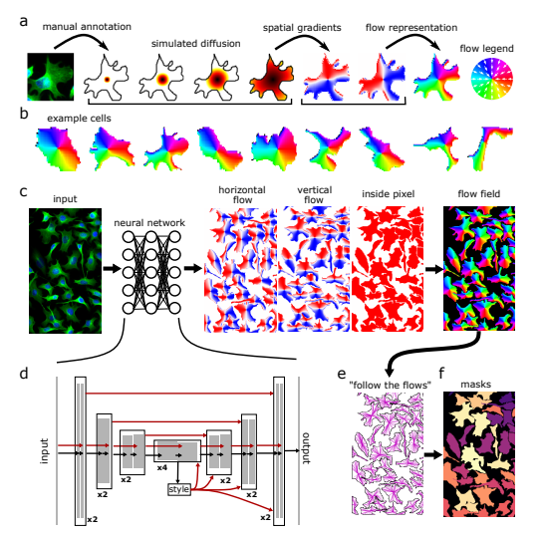
MODEL ARCHITECTURE

Slide 7
VECTOR FLOW REPRESENTATION

Slide 8
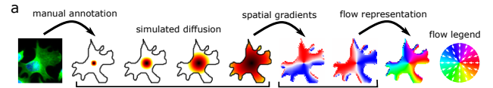
Procedure for Transforming Manually Annotated Masks into a Vector Flow Representation
The model architecture of Cellpose includes a procedure for transforming manually annotated masks into a vector flow representation that can be used as input to the neural network. This vector flow representation is derived using a simulated diffusion process that starts at the center of the mask and spreads outwards.
During this diffusion process, spatial gradients are computed at each pixel in the mask. These gradients point towards the center of the cell, even around corners and edges. The X and Y components of these gradients are then combined into a single normalized direction, represented by an angle between 0 and 360 degrees.
In other words, this procedure allows the model to capture the shape and orientation of the cell in a way that is robust to variations in the input image. By encoding the spatial gradients as a vector flow representation, the model can learn to segment cells with high accuracy, even in cases where traditional segmentation methods might fail.

Slide 9
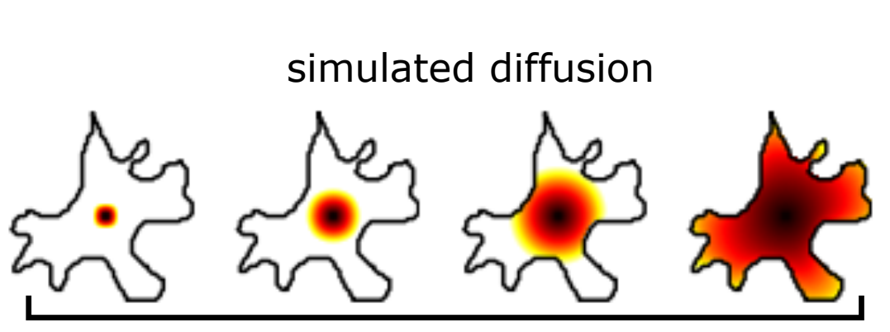
SIMULATED DIFFUSION (1)
The simulated diffusion process used in Cellpose is based on the idea of computing a distance transform of the manually annotated cell masks. A distance transform is a technique that assigns a distance value to each pixel in the image based on its proximity to the nearest boundary. In this case, the boundary is the edge of the manually annotated mask.
The distance transform is computed using a variant of the Fast Marching Method, which simulates the propagation of a wavefront through the image. Starting at the center of the cell mask, the wavefront is propagated outward in all directions until it reaches the edge of the mask. The distance transform is computed by measuring the distance of each pixel to the point where the wavefront passed through it.

Slide 10
SIMULATED DIFFUSION (2)
Once the distance transform is computed, the spatial gradients are derived by computing the gradient of the distance transform at each pixel. These gradients point towards the center of the cell and are used to compute the normalized direction of the vector flow representation.
The simulated diffusion process is a key part of the Cellpose model architecture, as it allows the model to capture the shape and orientation of the cell in a way that is robust to variations in the input image. By encoding the spatial gradients as a vector flow representation, the model can learn to segment cells with high accuracy, even in cases where traditional segmentation methods might fail.

Slide 11
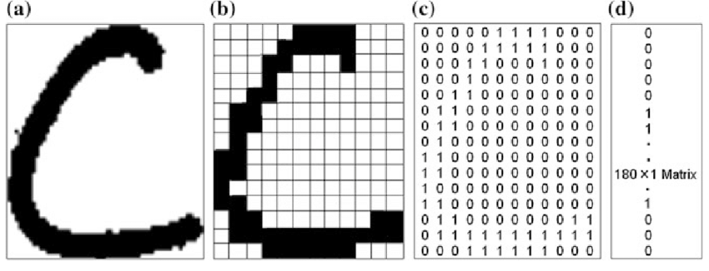
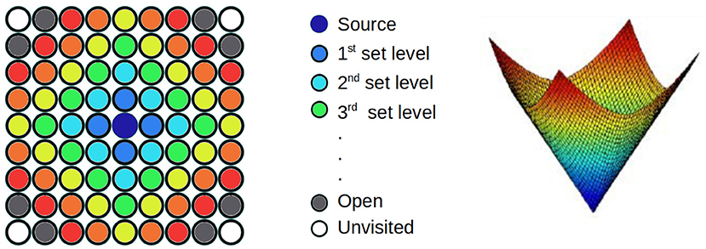
Ref. Fast Marching Method (FMM)
The Fast Marching Method is an algorithm for computing distance transforms of binary images. The basic idea of the method is to simulate the propagation of a wavefront through the image, starting from the set of pixels that are known to be on the boundary of a given region of interest.
The wavefront is initialized at the boundary pixels and is propagated through the image by updating the distance values of neighboring pixels based on the distance of the wavefront at the current location. The update rule is designed in such a way that the distance values are always non-negative and decrease monotonically as the wavefront propagates through the image.
The Fast Marching Method is widely used in image processing applications, such as medical image segmentation, shape analysis, and computer vision. In the context of Cellpose, it is used to compute the distance transform of the manually annotated cell masks, which is then used to derive the spatial gradients for the vector flow representation.

Slide 12
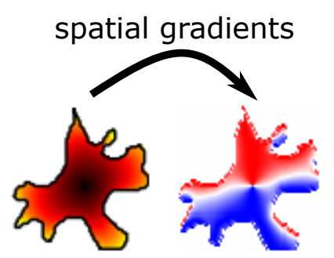
SPATIAL GRADIENTS (1)
FMM is used in the simulated diffusion part of the Cellpose algorithm to compute the distance transform of the manually annotated cell masks. The spatial gradients are then derived from the distance transform and used to compute the vector flow representation.
Starting at the center of the cell mask, the wavefront is propagated outward in all directions until it reaches the edge of the mask. The distance transform is computed by measuring the distance of each pixel to the point where the wavefront passed through it.
Once the distance transform is computed, the spatial gradients are derived by computing the gradient of the distance transform at each pixel. These gradients point towards the center of the cell and are used to compute the normalized direction of the vector flow representation.

Slide 13
SPATIAL GRADIENTS (2)
The spatial gradients are a key part of the Cellpose model architecture, as they provide information about the orientation and shape of the cell that is used to improve the accuracy of the segmentation. By encoding the spatial gradients as a vector flow representation, the model can learn to segment cells with high accuracy, even in cases where traditional segmentation methods might fail.
In summary, the spatial gradients in Cellpose refer to the direction and magnitude of change in the distance transform of the manually annotated cell masks. They are used to compute the vector flow representation, which is a key component of the Cellpose model architecture.

Slide 14
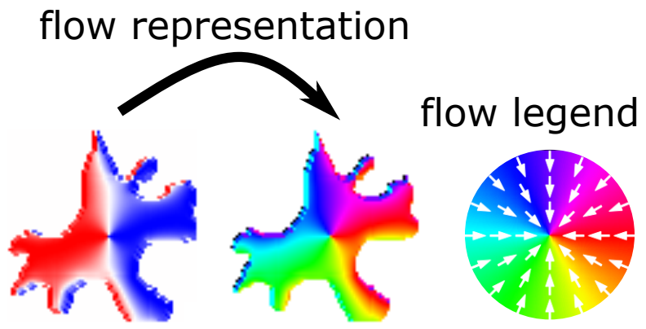
Flow Representation
Flow representation is a vector field that encodes the normalized direction of flow towards the center of each cell. The flow representation is derived from the spatial gradients, which are computed from the distance transform of the manually annotated cell masks using a variant of the Fast Marching Method.
To compute the flow representation, the spatial gradients are combined into a single normalized direction from 0◦ to 360◦, representing the direction of flow towards the center of the cell. This normalized direction is then used to compute a flow vector at each pixel in the image, which represents the direction and magnitude of flow towards the center of the nearest cell.

Slide 15
U-NET NEURAL NETWORK

Slide 16
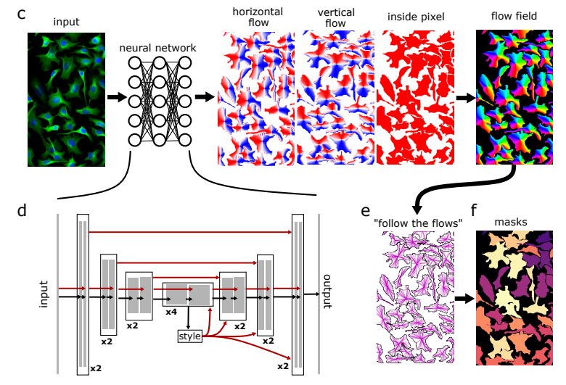
U-NET Neural Network

Slide 17
U-NET Neural Network
Input layer: The input layer of the Cellpose model takes as input a grayscale microscopy image.
Encoding layers: The encoding layers of the model are organized in a U-shaped architecture, with multiple convolutional layers and max-pooling layers used to gradually reduce the spatial dimensions of the image while increasing the number of feature maps.
Bottleneck layer: The bottleneck layer of the model is a narrow layer with high feature map density that captures the most important features of the image.
Decoding layers: The decoding layers of the model are organized in a U-shaped architecture that is similar to the encoding layers, but in reverse order. These layers use transposed convolutional layers and upsampling layers to gradually increase the spatial dimensions of the feature maps while decreasing the number of feature maps.
Output layer: The output layer of the model is a sigmoid activation layer that generates a probability map for each pixel in the input image, indicating the likelihood of that pixel belonging to a cell.

Slide 18
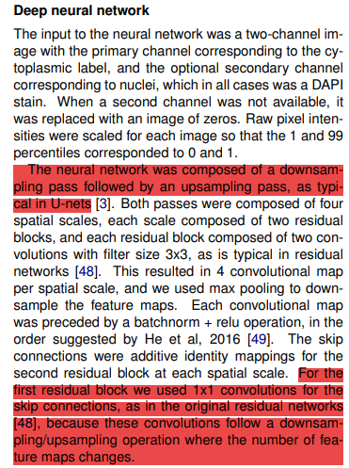
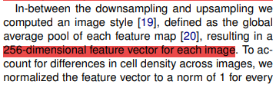
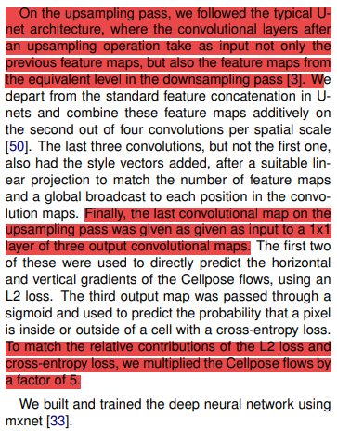
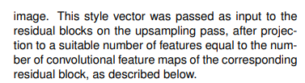
U-NET ARCHITECTUE

Slide 19
Downsampling (Paper described)
For skip connections
Spatial scales
1 x 1 convolution feature map
Residual
block
Residual
block
Max
pooling
Batch
norm
relu
INPUT
224 * 224 images
X 4
3x3
filter
3x3
filter
If no padding and no stride, then size only will be squeezed in the maxpooling layer

Slide 20
Upsampling (Paper described)
For skip connections
Spatial scales
1 x 1 convolution feature map
Residual
block
Residual
block
Batch
norm
relu
X 4
3x3
filter
3x3
filter

Slide 21
Ref. U-NET Architecture Estimation

Slide 22
APPENDIX. STYLE TRANSFER
In computer vision, style transfer refers to the process of transferring the style or visual appearance of one image to another image, while preserving the content of the latter. This technique is typically achieved using deep neural networks, specifically convolutional neural networks (CNNs).
The general idea behind style transfer is to use a pre-trained CNN to extract the style information from a "style" image, and then apply that style to a "content" image while preserving the content of the latter. The CNN is usually trained on a large dataset of images, such as ImageNet, and can extract feature maps that capture the visual style of an image, such as its colors, textures, and patterns.
To perform style transfer, the feature maps of the style image are used to define a Gram matrix, which captures the correlations between the different feature maps. This Gram matrix is then used to transform the feature maps of the content image, so that they match the correlations of the style image. This process is usually done by optimizing a loss function that balances the content and style information.
The resulting image has the content of the original image, but with the visual style of the style image. This technique has a wide range of applications, including artistic stylization, image enhancement, and image synthesis.
In summary, style transfer in computer vision involves using a pre-trained CNN to extract the style information from a style image, and then applying that style to a content image while preserving the content. The style information is typically represented as a set of feature maps and is used to transform the feature maps of the content image using a Gram matrix.

Slide 23
RESULT

Slide 24
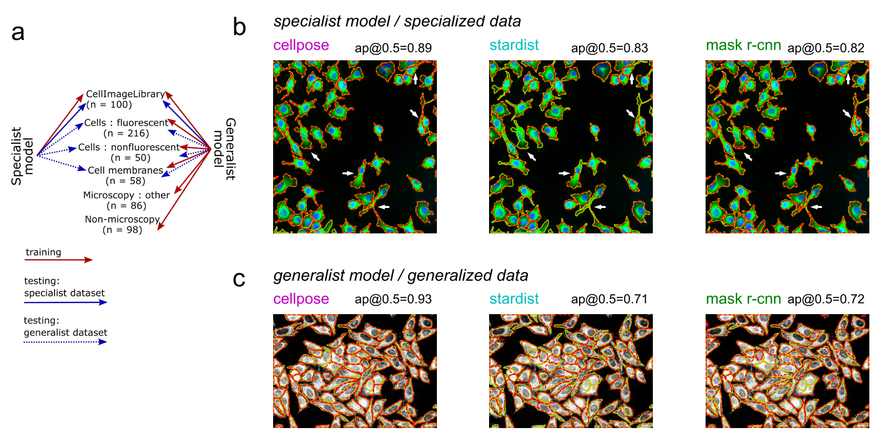
TRAINING METHODS

Slide 25
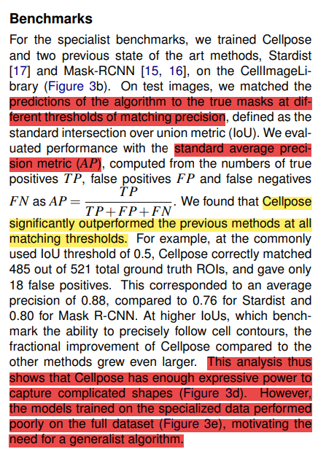
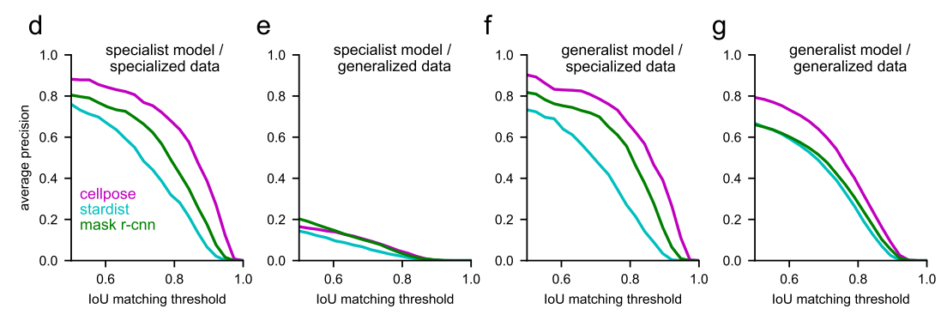
MODEL RESULT
Specialized data
This dataset consisted of 100 fluorescent images of cultured neurons with cytoplasmic and nuclear stains obtained from the CellImageLibrary
Generalized data
The full dataset included the 100 images described above, as well as 516 additional images from various source. All these extra images were fully manually segmented by a single human operator (MM).

Slide 26
E.O.D.

